Slide 1
Depth Map Estimation in 6G mmWave systems: round table
Steve Blandino, Raied Caromi, Jelena Senic

Slide 2





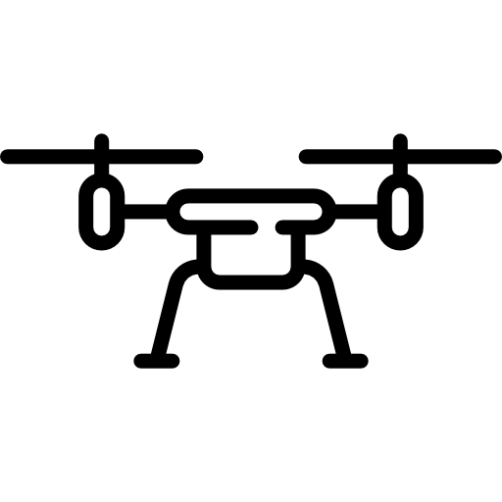

Acquiring multi-dimensional information
Sensor Networks
Integrated Sensing And Communication (ISAC)
IOT
Native multi-dimensional data
Extra hardware investment and power consumption.
Not scalable over large networks.
Source of a massive amount of data
Re-using same hardware and spectrum
Extra processing required to acquire multi-dimensional data

Slide 3

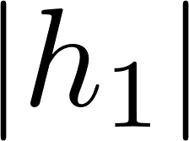

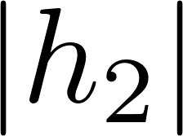
From communication devices to sensors
Integrated Sensing and Communication:
Reuse spectrum, devices and protocols to perform both communication and sensing.
Keep cost and power of future networks under control
Sensing can be performed on communication networks by tracking changes of wireless signals over time.
Time-variations of the wireless signal can be analyzed using signal processing, ML/AI or both.

Slide 4
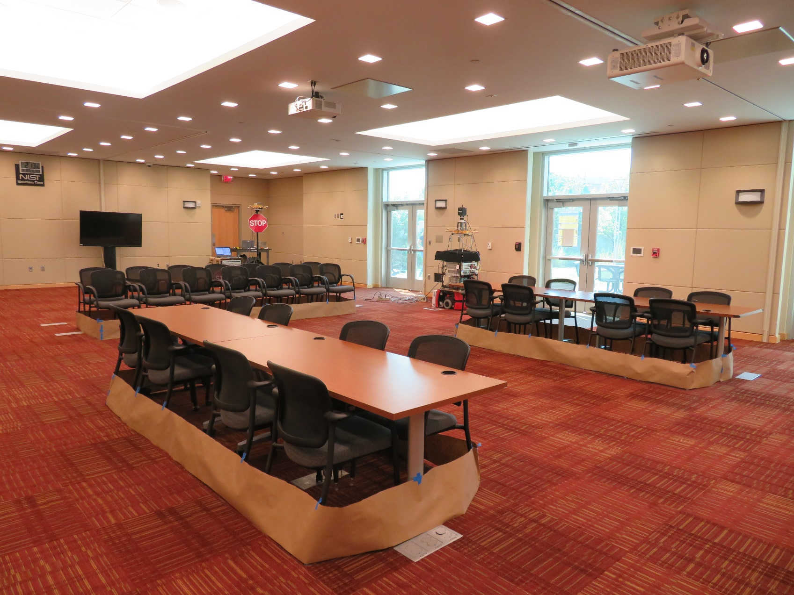
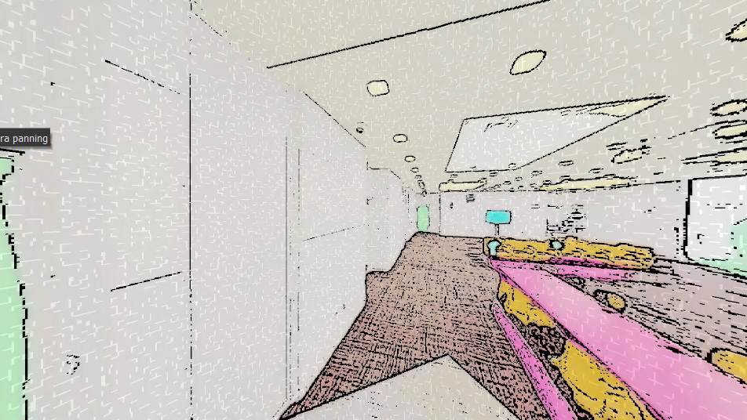
Communication waves to create a digital world
Physical world
Digital world
ISAC + AI/ML

Slide 5
Physical solutions in the digital world
Physical world
Digital world
ISAC + AI/ML
Inference
Simulation, verification, prediction, control…

Slide 6

Sensor data to design ML/AI models
IOT
Sensor Networks
ISAC Networks
Training ML/AI Models
Inference using RF communication signal

Slide 7

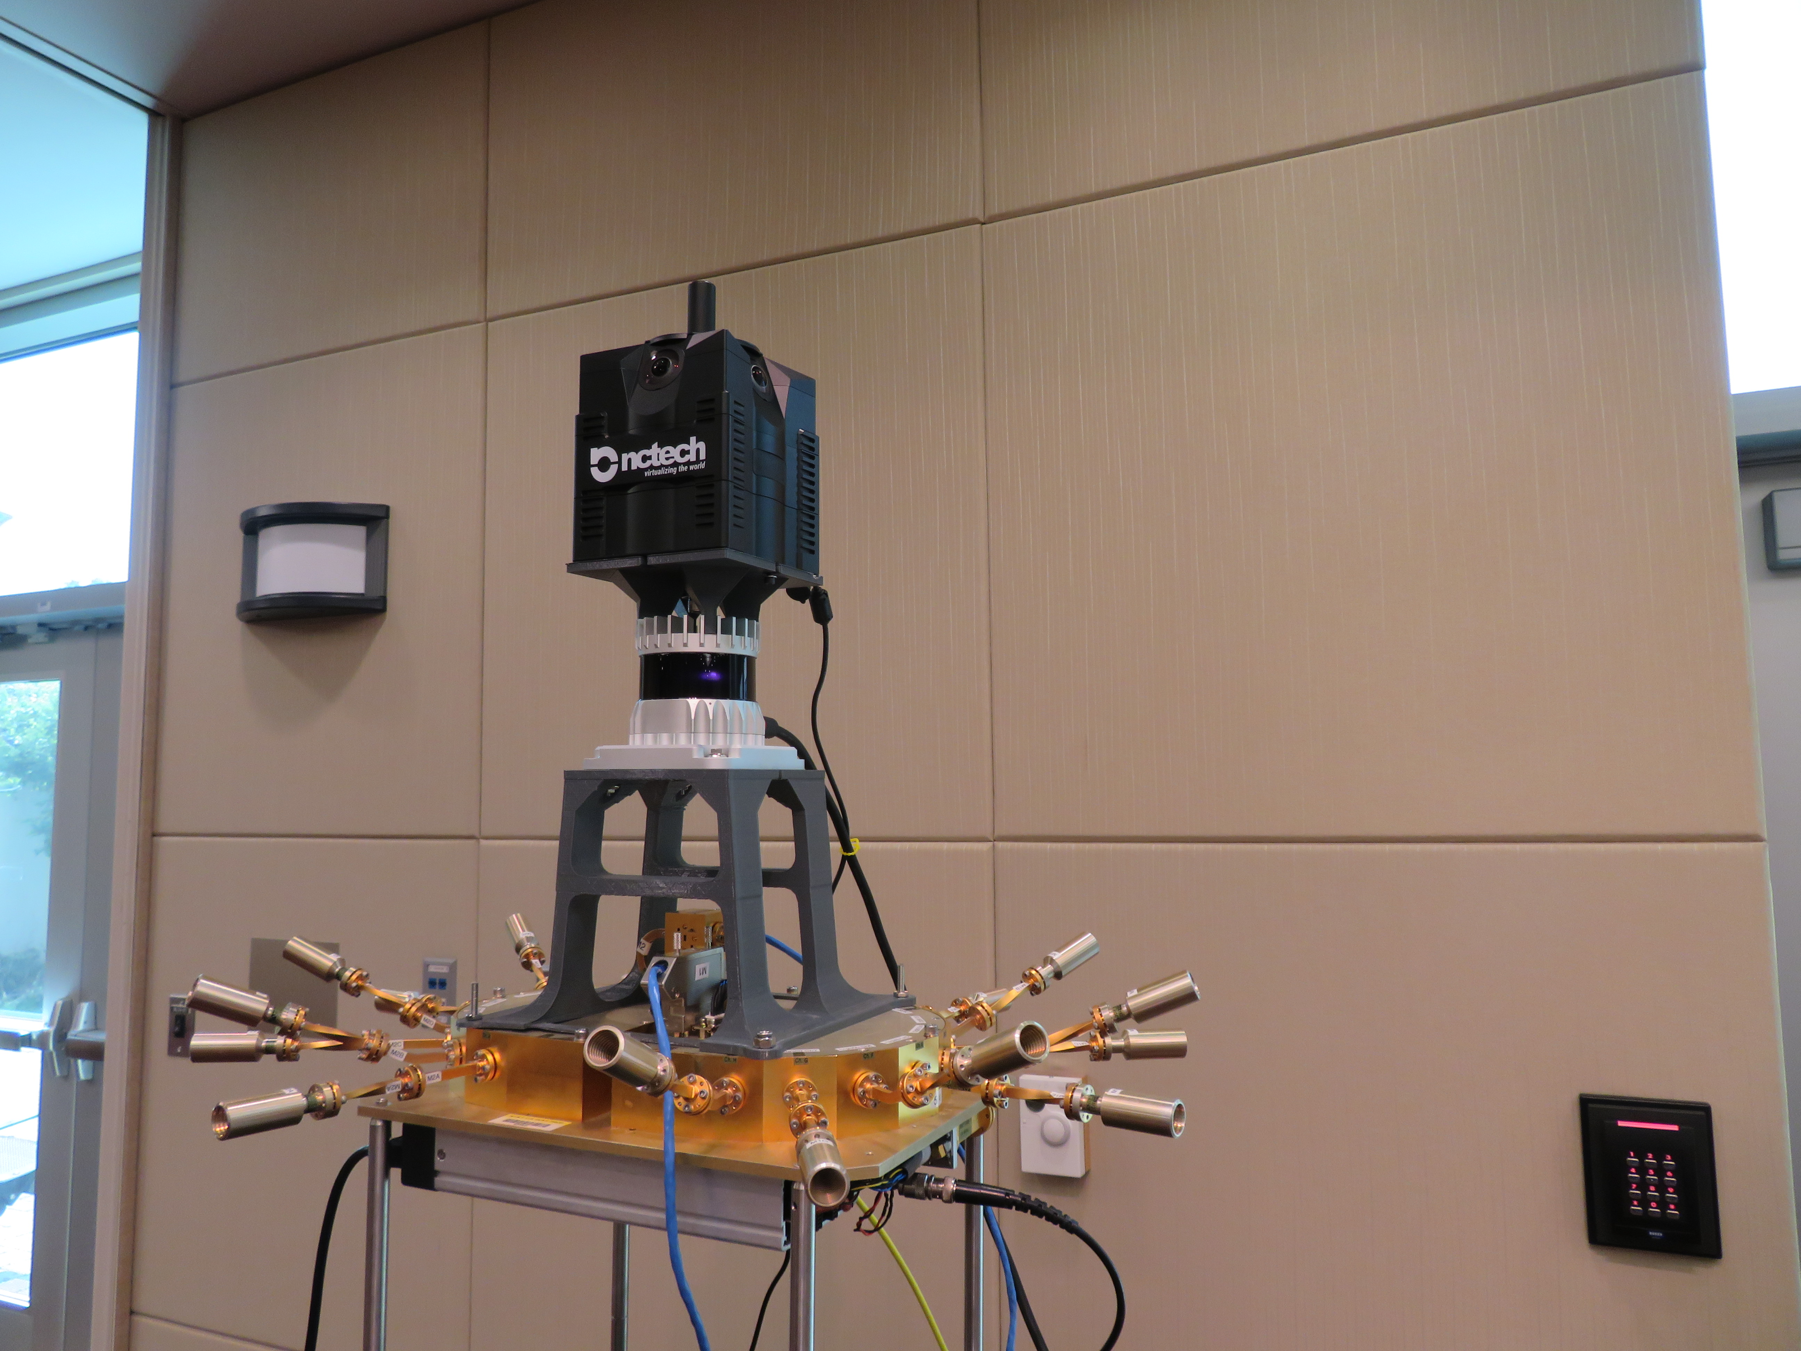
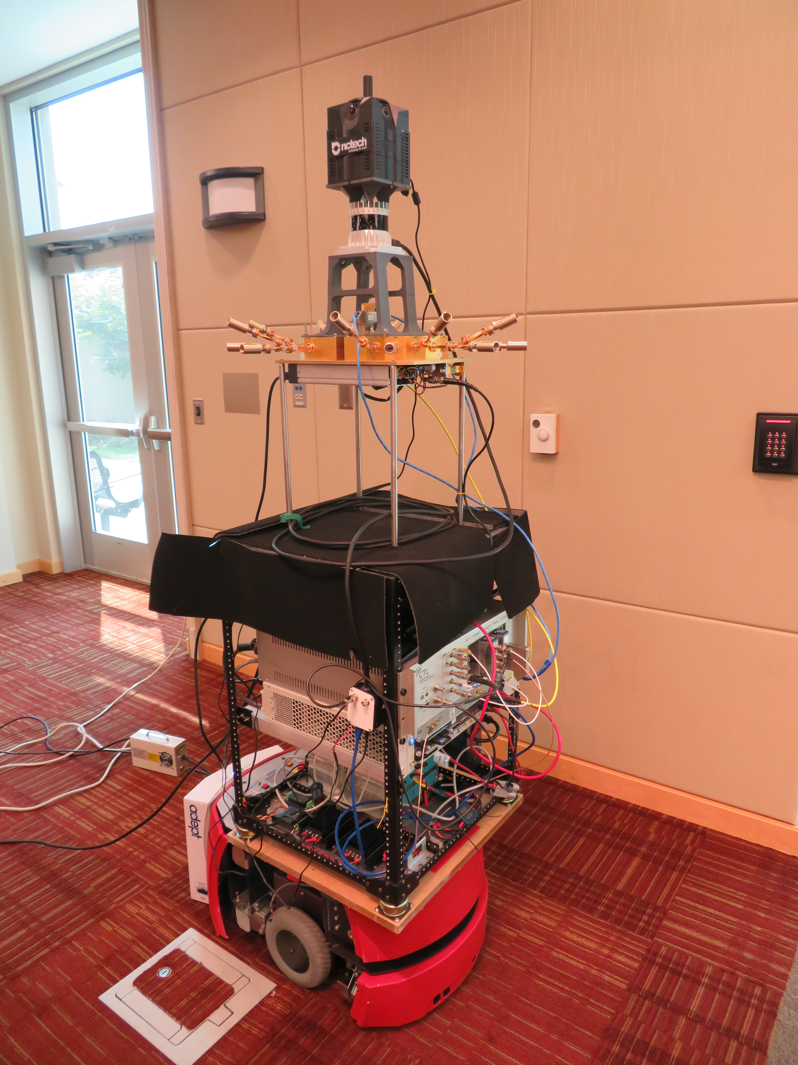
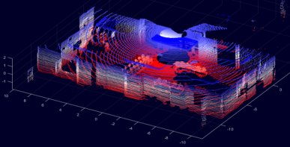
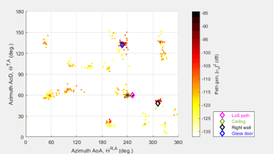
Measurement System & Data Collection
360° Camera
360° Lidar
Antenna array
While in motion, the receiver collected: RF data, 360° lidar data, and 360° photos of the environment.
Receiver

Slide 8
ITU AI/ML in 5G challenge

Slide 9

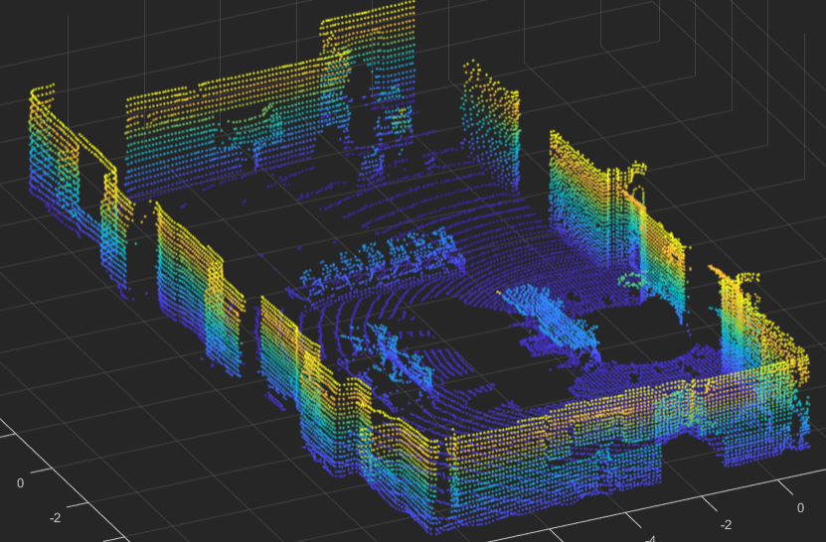
Depth Map estimation using mm-wave+ML
Two MIMO nodes
One fixed transmitter
One moving (position and orientation) receiver
Observation of environment changes over time
Relative to position and orientation of the receiver
Challenge: estimate the depth map of the environment at each receiver position, using mm-wave signals.
Physical world
Digital world

Slide 10
Challenge overview
Lidar
^{Performance evaluation}
MIMO
Channel
ML/AI model

Slide 11
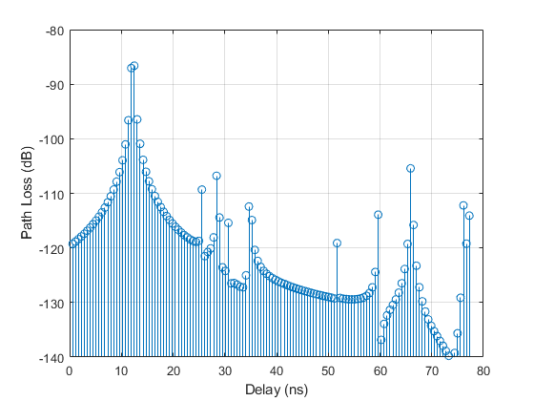
Training the model
Ground Truth: Training LiDAR dataset
Machine-Learning
^{Training Dataset}
Trained Model
Input Data: Training RF Dataset

Slide 12
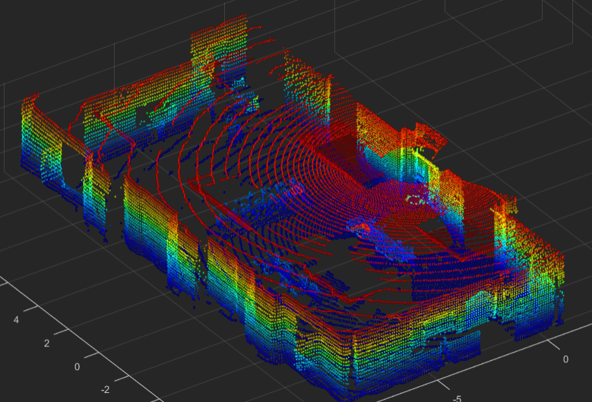


Evaluation of the model
Ground Truth: LiDAR Evaluation dataset
Trained Model
Input Data: RF Data Evaluation Dataset
Output: LiDAR Point Clouds
Evaluation
Training and evaluation dataset are collected in different areas of the room

Slide 13
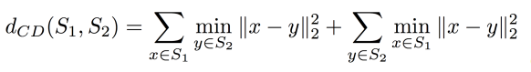


Evaluation metric: Chamfer Distance
Chamfer Distance measures discrepancies between point clouds.

Slide 14
Bonus
3D Environment Parsing and Reconstruction

Slide 15
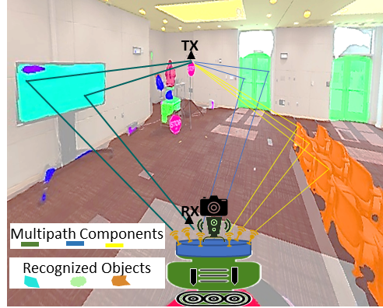
Channel Modeling
Context-aware RF measurement system
Accurate channel models → Reliable designs of wireless systems → Accelerate the deployment of nextG wireless systems
Machine learning enables fast processing of large volumes of data for accurate channel modeling
Environment parsing via object recognition and segmentation
Automated 3d modeling of the environment
Automate the mapping of the multipath components to the objects
Predict channel models of new environment from 3d models

Slide 16
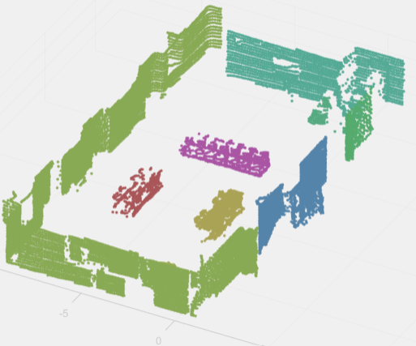
3D Environment Reconstruction: Modeling
1
Object Recognition
Semantic segmentation
Panoptic segmentation
Point cloud semantic
segmentation
Depth map estimation
Simultaneous Localization
and Mapping (SLAM)
2
3
Camera-LiDAR Sensor
Fusion
3D modeling
Example: B. Pitzer, S. Kammel, C. Duhadway and J. Becker, "Automatic reconstruction of textured 3D models," 2010 IEEE International Conference on Robotics and Automation, 2010, pp. 3486-3493.

Slide 17
3D Environment Reconstruction: Evaluation
Point-based qualitative evaluation (30 points Total)
Ideal solution: Automatic generation of the 3d MAP of the environment with material definition of every object. E.g. Wavefront OBJ and Material Template Library (MTL)
Subproblem solutions evaluation:
Subproblem solution | Points
1. Image-based machine learning algorithms | 0-15
2. Point cloud algorithms | 0-10
3. Sensor fusion and 3d Modeling | 0-5
Total | 0-30

Slide 18
DataSET and File format

Slide 19
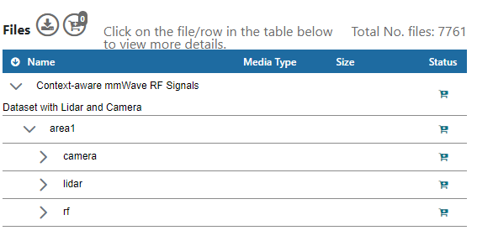
Dataset
Training dataset (Area1): "Context-aware mmWave RF Signals Dataset with Lidar and Camera"
Dataset website: https://doi.org/10.18434/mds2-2645
Challenge and dataset related code @GitHub: https://github.com/usnistgov/ML5G-PS-004
File Naming:
FileTypePrefix_<X*10^6+Index>.ext, where FileTypePrefix refers to the type of the file, X is area number, Index=[0, 1, 2, ….., N-1], N is number of cases, and ext is the file extension (mat, pcd, jpg).

Slide 20
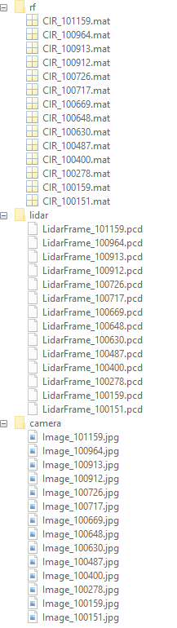
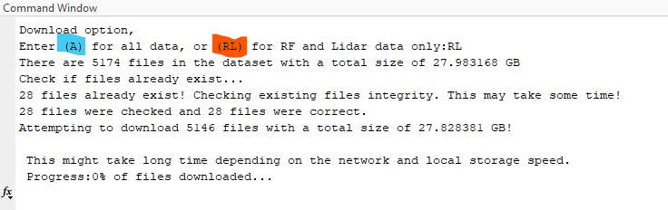
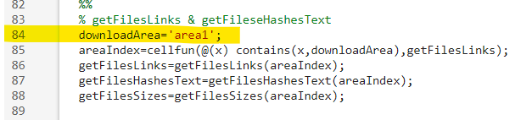
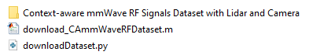
Dataset Download
https://github.com/usnistgov/ML5G-PS-004
git clone https://github.com/usnistgov/ML5G-PS-004.git

Slide 21
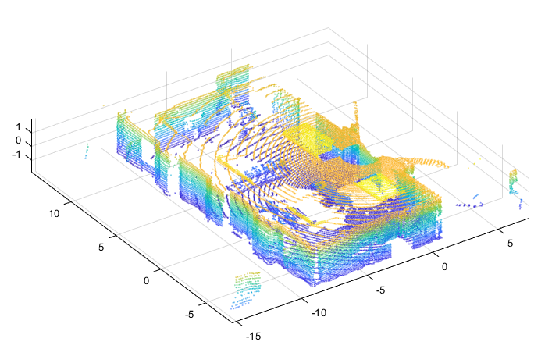
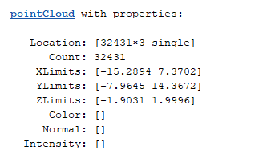
Lidar file format
Lidar type: Ouster OS0-128
Point cloud file format: PCD (binary) https://pointclouds.org/documentation/tutorials/pcd_file_format.html
Point cloud data format: Unorganized and downsampled
Datatype: Single (f32)
How to read point cloud data:
MATLAB ( recommended 2020b or newer)
Python, e.g. Open3d and pyntcloud
Example:

Slide 22
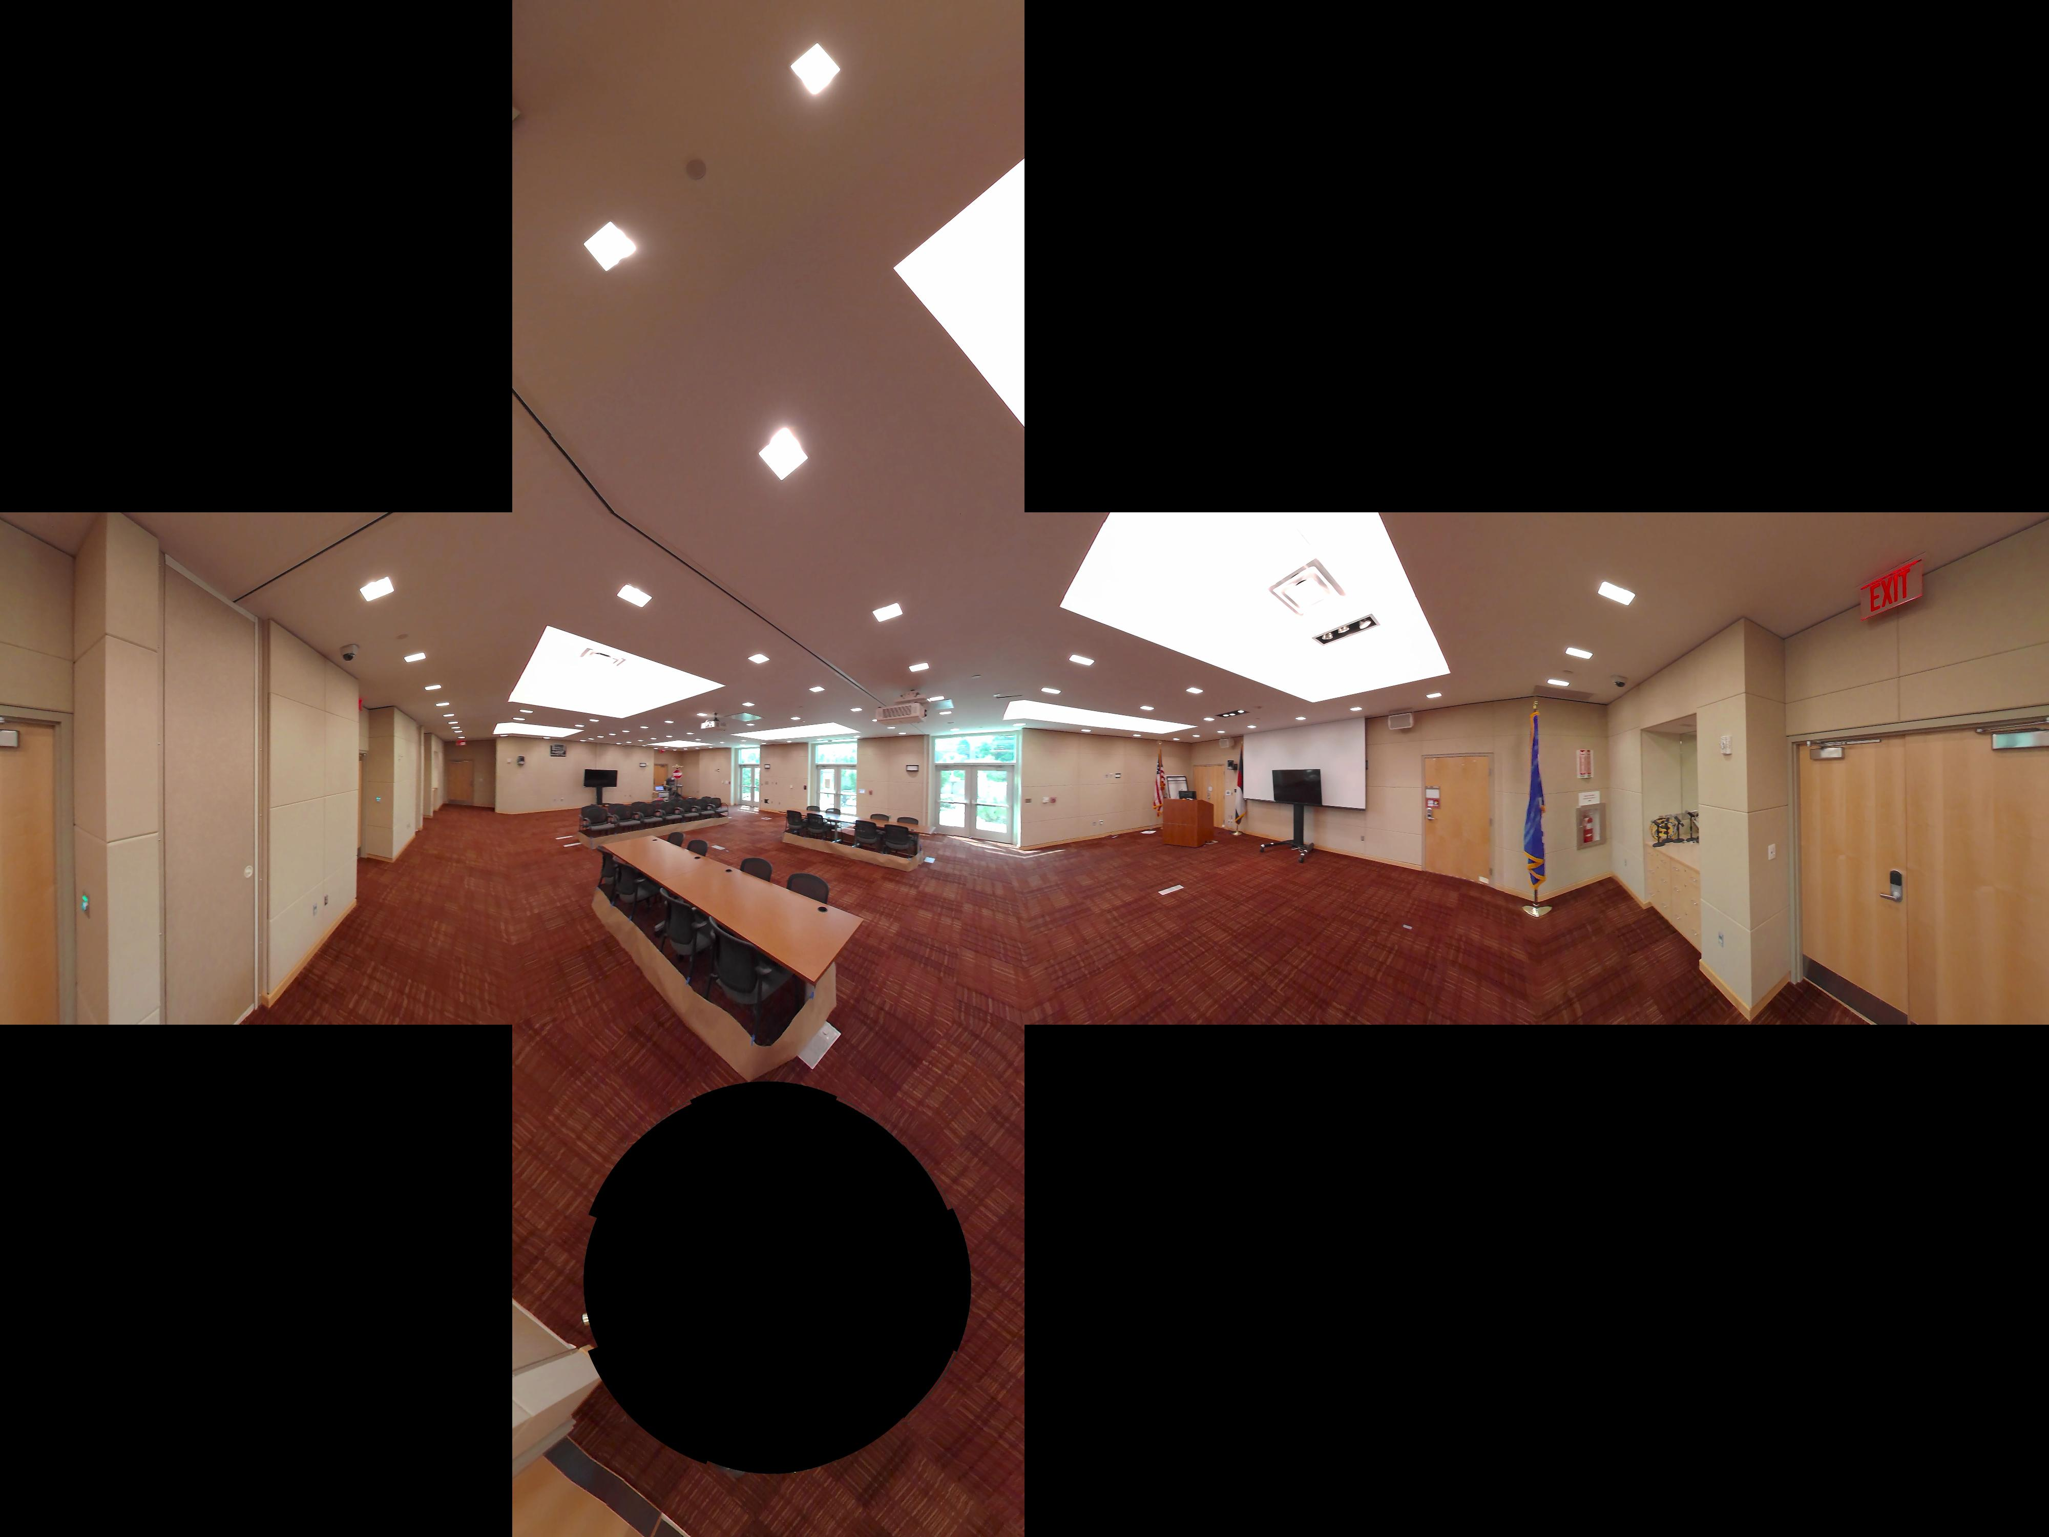
Image file format
Image resolution: 11000x5500
File type: JPG
Projection: 360 image, Equirectangular
Cubemap projection
Equirectangular projection

Slide 23
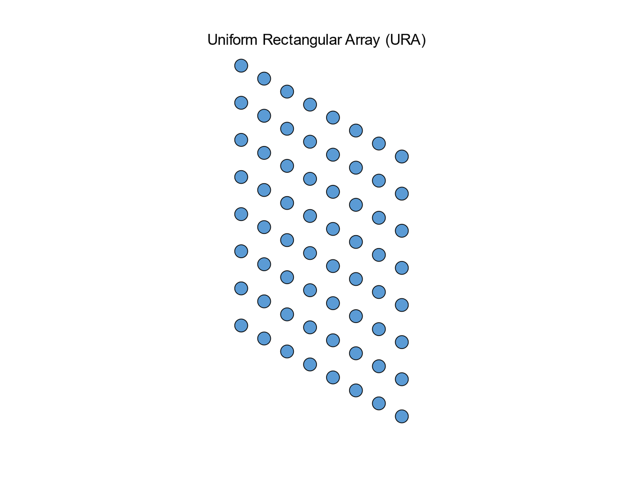
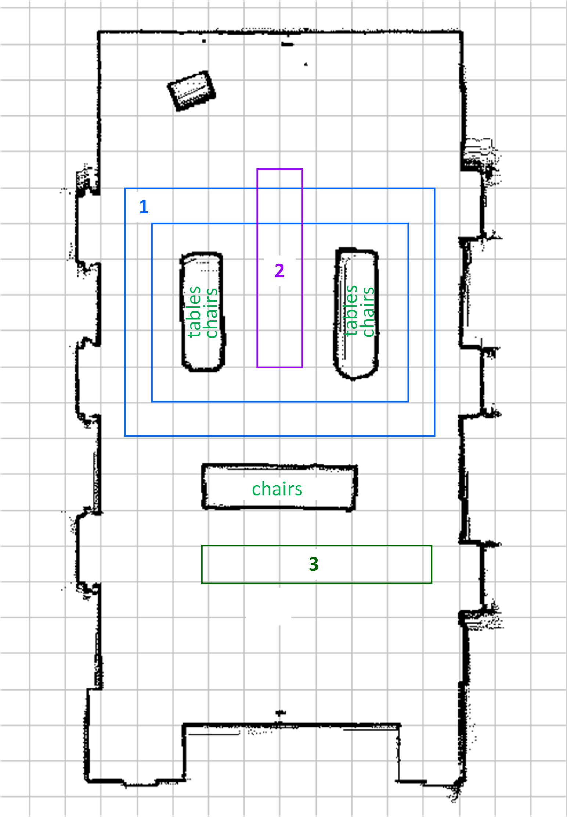

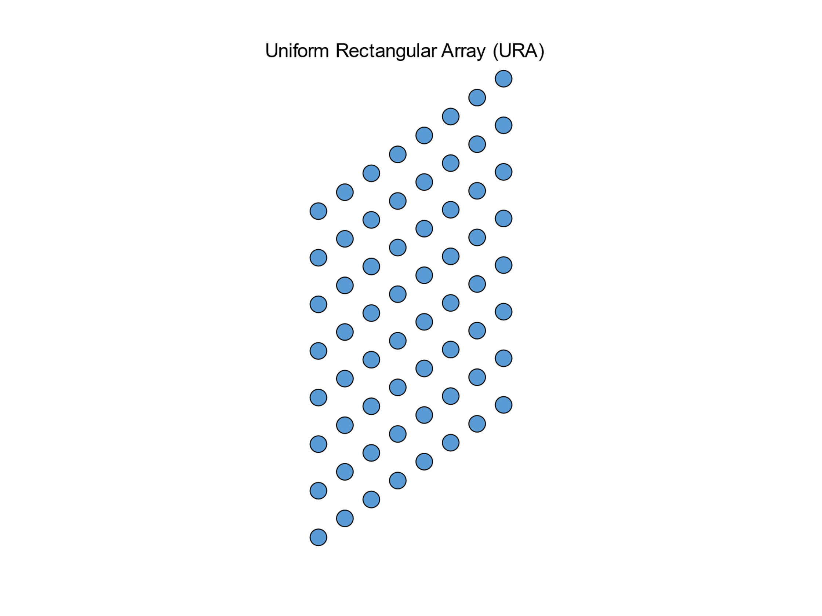
MIMO channel impulse response
RX
8×8
TX
8×8

Slide 24
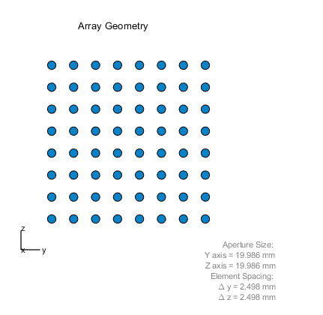
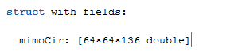
RF data file format
MIMO CIR format: .mat
Rx antennas × Tx antennas × Delay taps
Delay sampled at 1.76GHz

Slide 25
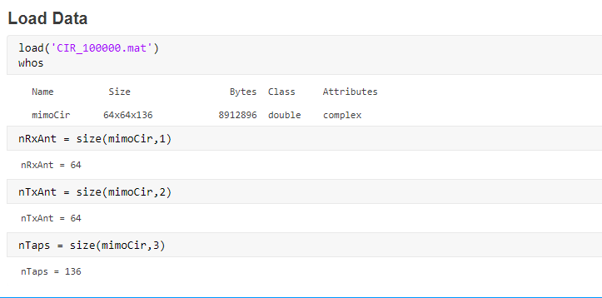
Load data

Slide 26
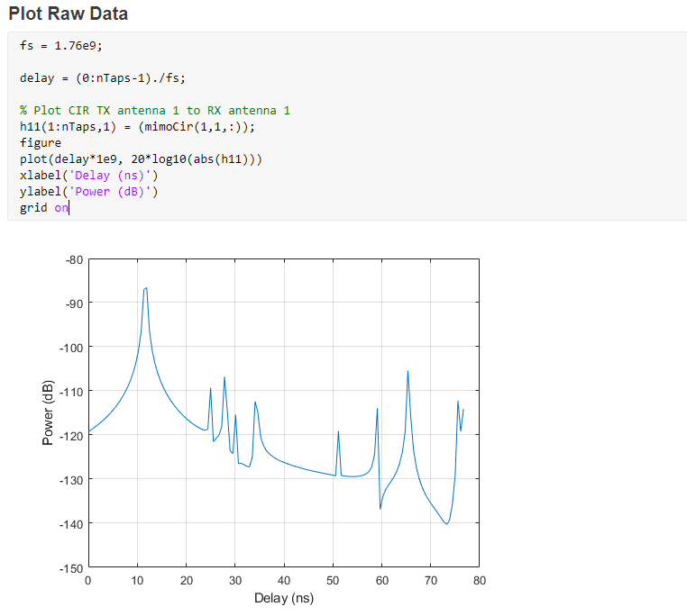
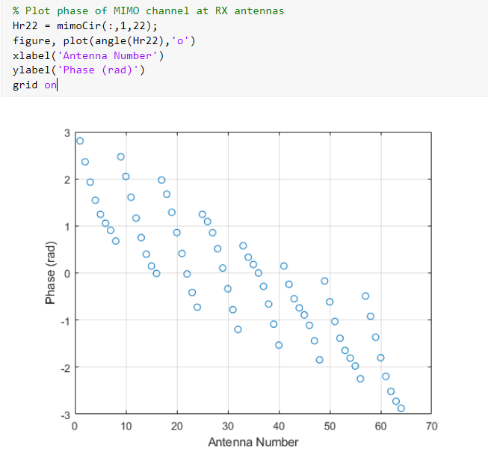
Plot Raw Data

Slide 27
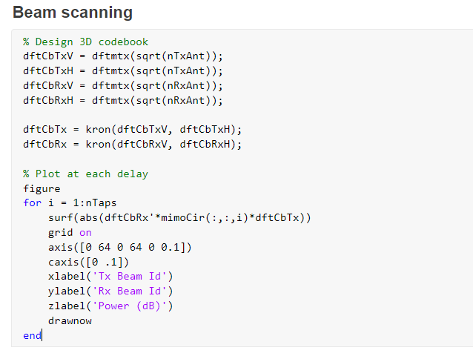
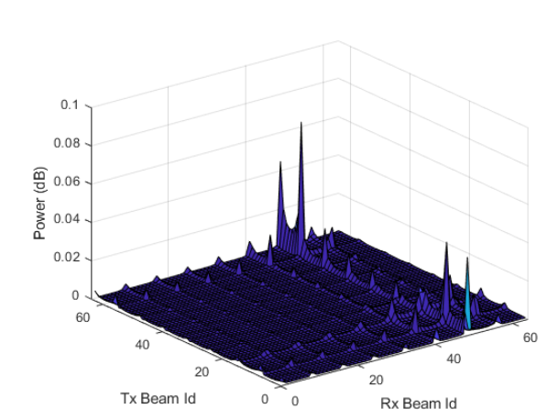
Beam scanning example

Slide 28
Q/A

Slide 29




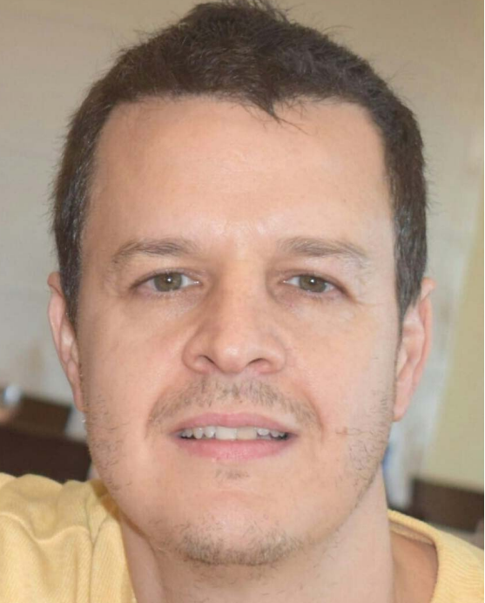




Team
Steve Blandino
Anuraag Bodi
Raied Caromi
Jack Chuang
Camillo Gentile
Nada Golmie
Chiehping Lai
Tanguy Ropitault
Jelena Senic

